Slide 1

Home AUTOMATION
CHANDAN G
CHINMAYI TEGGI
DHEERAJ D KAMATH
JAHNAVI REDDY
1BM14EC019
1BM14EC022
1BM14EC027
1BM14EC046

Slide 2
introduction
To control appliances such as light and fan with the help of a phone avoiding the need for manual intervention
Components required:
LPC1343
ESP8266 (Wi-Fi Module)
LDR Sensor
mX-Baseboard
Software:
LPCXpresso
Keil V5
Android Studio

Slide 3
PROBLEM STATEMENT
The main challenge faced today in households is high power consumption. Also, with the advent of technology, everyone today has a mobile phone. The remotes used today for switching are redundant hardware and waste of money.
User comfort has become another luxury and calls for intelligent devices which can sense the surrounding and take decisions on their own.
Sensing can include temperature, light intensity, phone signals, thereby having a system which can work automatically as well as respond to user requests.

Slide 4
Proposed solution
With the help of LPC1343 as the main controller, interfaced with:
ESP8266 which will create a server
LDR based Light Detector which will sense light in the room
Mobile App that can control all the appliances in the room
Object sensor that will detect the presence of user in the room
This creates an efficient system that can be used to automate the home with features like:
Manual control by the user
Efficient power saving
User comfortability

Slide 5
Project Work FLow

Slide 6
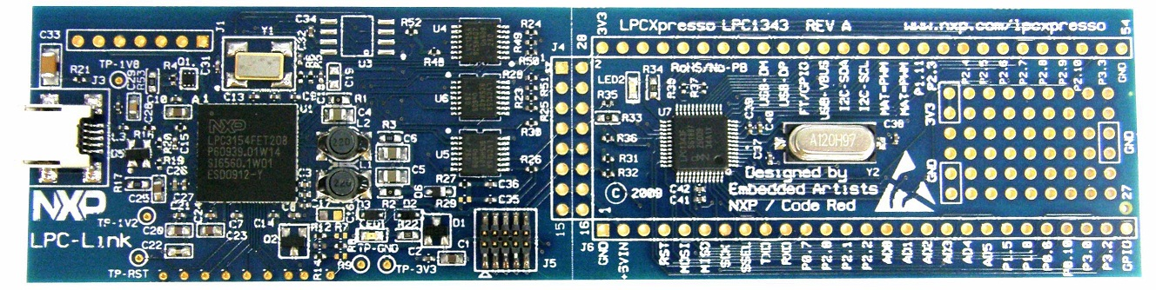
Implementation

Slide 7
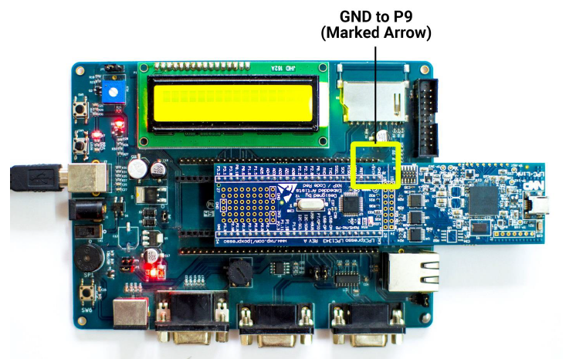

Slide 8
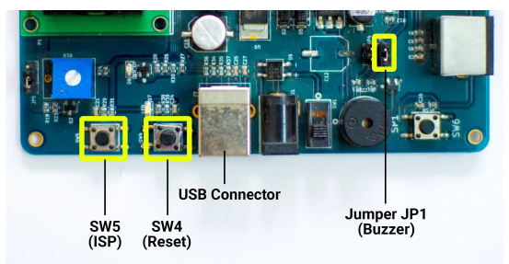
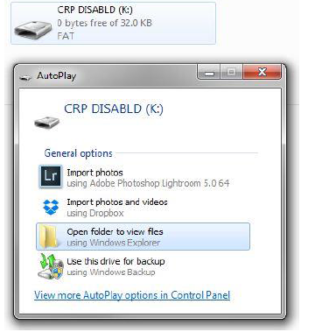

Slide 9
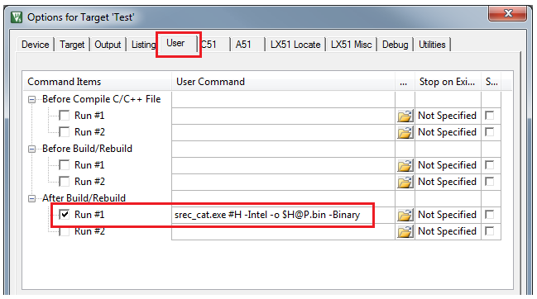
Generating bin using keil
All the codes written in Keil generate a .hex file but LPC only accepts .bin files, hence we convert them in the following fashion:

Slide 10
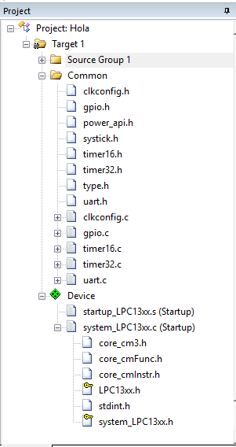
Coding in keil
Libraries used:
Gpio – For accessing functionalities of GPIO pins
Timer – For synchronizing time, interrupts and for delays
Uart – Communication protocol using tx and rx
startup_lpc13xx – Defines all the registers and functionalities of LPC
System_lpc13xx – Initializes the LPC clock and registers through polling
Various other header files can be added according
to application like
lcd.c
adc.c
blinky.c

Slide 11
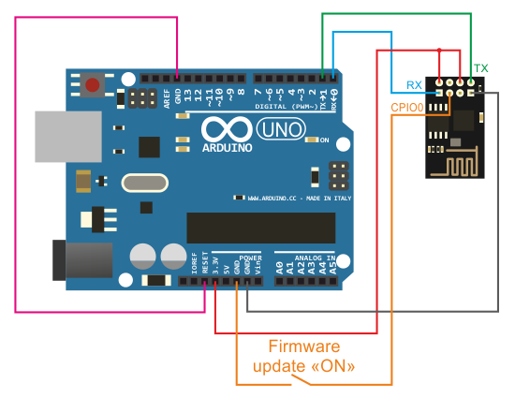
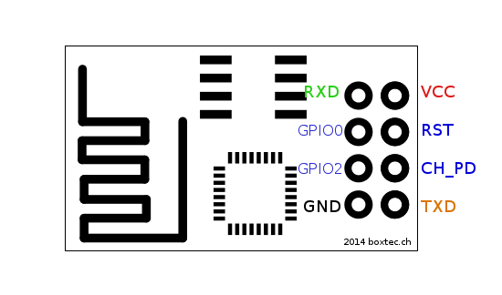
ESP8266
PINOUT

Slide 12
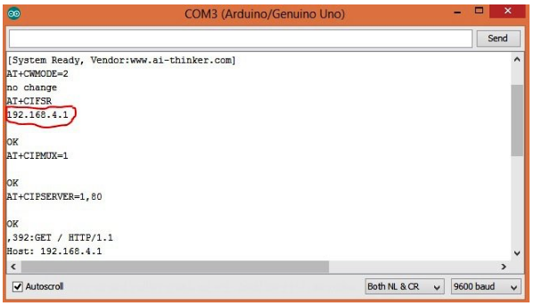
SERVER SET UP

Slide 13
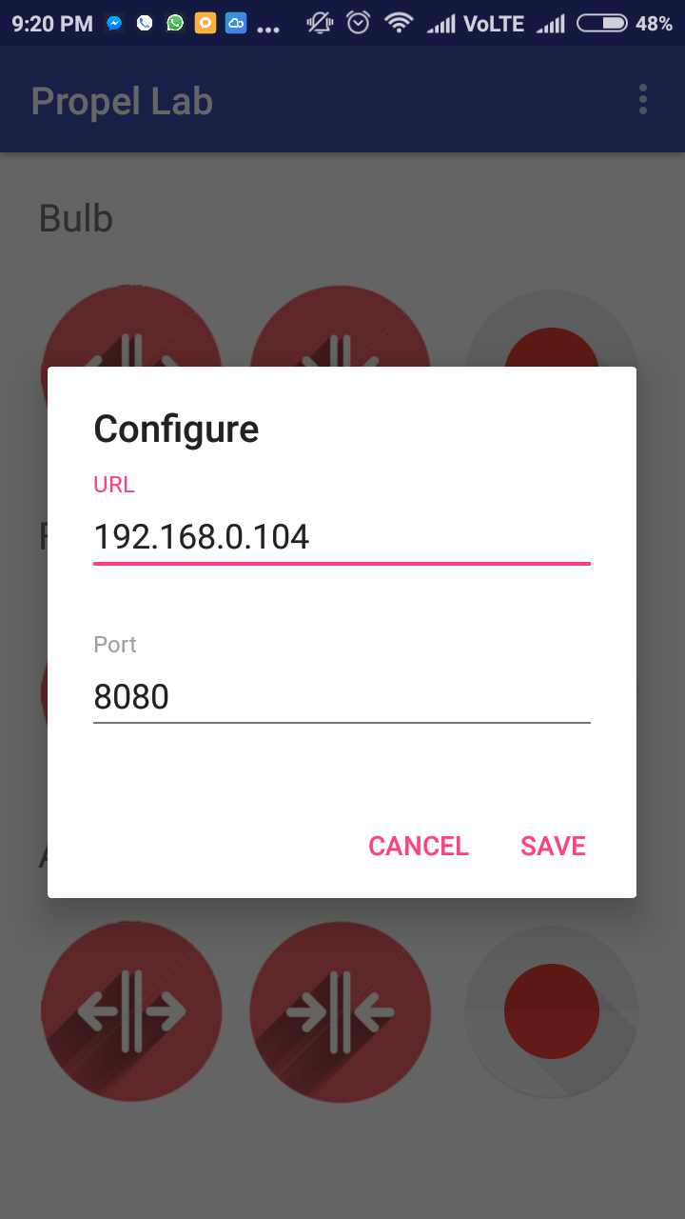
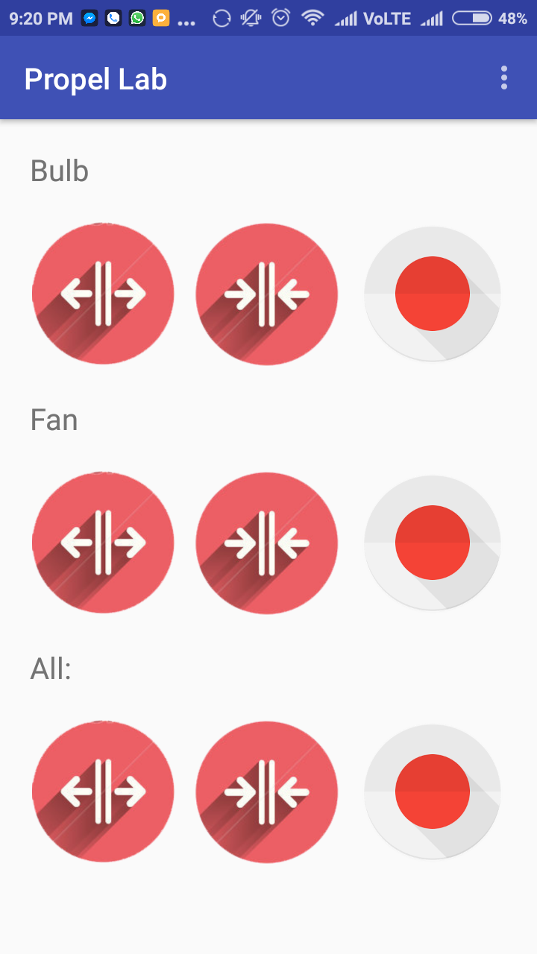
Android Mobile app

Slide 14
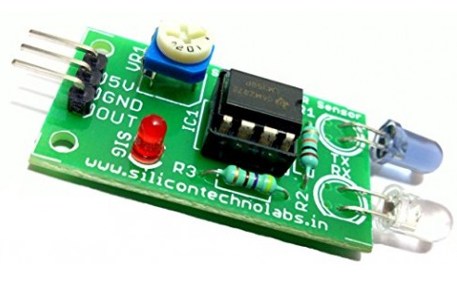
Automatic control
The ESP Module should only be active only when the user is in the house. To ensure this, we use an object sensor that senses if the user is present or not
The output of the Object Sensor
is given to the LPC for ADC
Conversion. Then the digital output
from LPC will be given to enable
of the ESP module.

Slide 15
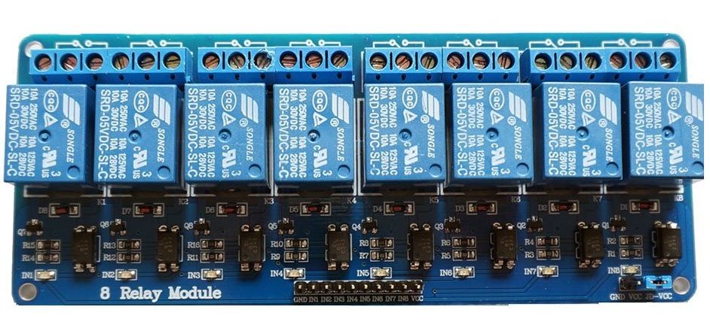
8 channel relay

Slide 16
Thank you

